Slide 1
IV-SEMESTER, II B.Sc.
TYPES OF EGGS
DR. B.D.J. Satya Latha, lecturer in Zoology, GCW(A), On duty basis, Guntur.

Slide 2
EGG
The egg is the female gamete. It is called ovum.
It is an architectural marvel.
The egg contains almost all the materials which are essential for the entire process of development.

Slide 3
It has three important functions. They are:
It supplies haploid set chromosomes to the future embryo.
It supplies almost all the cytoplasm of the egg to the embryo and
It supplies food to the developing embryo.

Slide 4
Eggs are spherical in shape.
But in a few animals, as in insects, the eggs are elongated and cylindrical.
The eggs of the hag fish Myxine and those of the ganoid fishes are oval in shape.
The eggs of birds are also oval in shape externally, but their egg cells are really spherical in shape.

Slide 5
Egg Membranes
The eggs are well protected by egg membranes.
The membranes are produced either by the egg itself or
by the follicle cells of the ovary or by the genital ducts of the mother.
Accordingly, the egg membranes are classified into three types. They are
1.Primary membranes 2.Secondary membranes and 3.Teritiary membranes.

Slide 6
Primary Membranes :
Plasma membrane: It is the membranes covering the egg immediately over it. It is found in all the egg. In the structure, it
resembles the plasma membrane of atypical cell.
Vitelline membrane: It is closely attached to the plasma membrane of the egg. It is found in the eggs of the majority of animals like insects, molluscs, echinoderms, Amphibians, birds
etc; it is very thin and transparent. It is formed of
mucoploysachharides and fibrous protein. After fertilisation the
membrane is called fertilisation membrane.

Slide 7
Chorion: it is found in the eggs of lower chordates like fishes. It
is a product of surface ooplasm.
Zona radiata: the egg of the shark Scyllium canicular, has two primary membranes produced by the surface ooplasm. The outer membrane is the vitelline membrane and the inner
membrane has a radiating appearance and hence
called zone radiata. The eggs of teleost fishes are also covered by zone radiata.

Slide 8
5. Zona Pellucida: All mammalian eggs are surrounded by a membrane called zone pellucida . It is also named
as zone radiata. It is so named as because it gives a striated appearance under the microscope. The striations re due to the presence of microvilli and
microvilli (desmosomes) in this zone. The microvilli are
produced by the surface of the egg and microvilli are produced by the follicle cells. They protrude into the zone pellucida.

Slide 9
6. Jelly coat: the eggs of aquatic invertebrates, especially the homolecithal eggs of marine
invertebrates, are covered by a non-living jelly-like layer outside the vitelline membranes is called Jelly coat.

Slide 10
Secondary membranes
The secondary membranes are produced by the follicle cells of the ovary.
These membranes are usually tough and impermeable.
The secondary membranes are as follows:

Slide 11
Chorion: this is a common outer covering in the eggs of insects, ascidians and cyclostomes. It is found
outside the vitelline membrane. As the chorion is tough and impermeable it is proved with one or more openings called micropyles through which the sperms enter the egg.
Corona radiata: It is found in mammalian eggs. This membrane is formed of a layer of follicle cells. The cells
are radically arranged around the zone pellucida.

Slide 12
Tertiary membranes
White albumen It is found in the egg of hen. It is found outside in the vitelline membrane. Its is formed of three layers and inner less dense albumen, middle
dense albumen and an outer less dense albumen.
Shell membrane The shell membrane is formed around the albumen in the egg of hen. It is a double
membrane. This membrane is formed of keratin.

Slide 13
C) Shell The shell is the outer covering of land animals eggs. It is formed of calcium carbonate. It is white or
brown in coloraturas. It contains as many as 7000 minute pores. They are filled with a proteins substance filled to collagen.

Slide 14
D) Jelly Coat
It serves to attach the eggs to each other and to other objects so that they are not readily washed away by water current.
It protects the egg from mechanical injury.
It appears to be distasteful to predators.
It reduces the chances for polyspermy.
It prevents infectious from fungus and other germs.

Slide 15
Patterns of Eggs
Eggs are classified mainly on basis of
Amount of yolk
Distribution of yolk
Presence or absence of shell
Type of development.

Slide 16
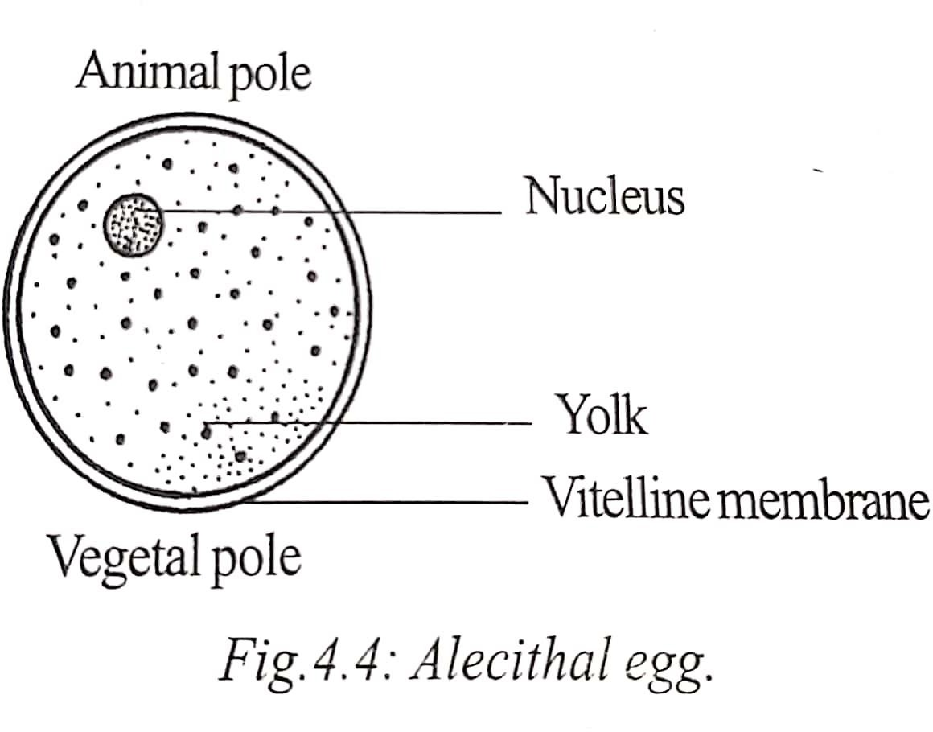

Slide 17
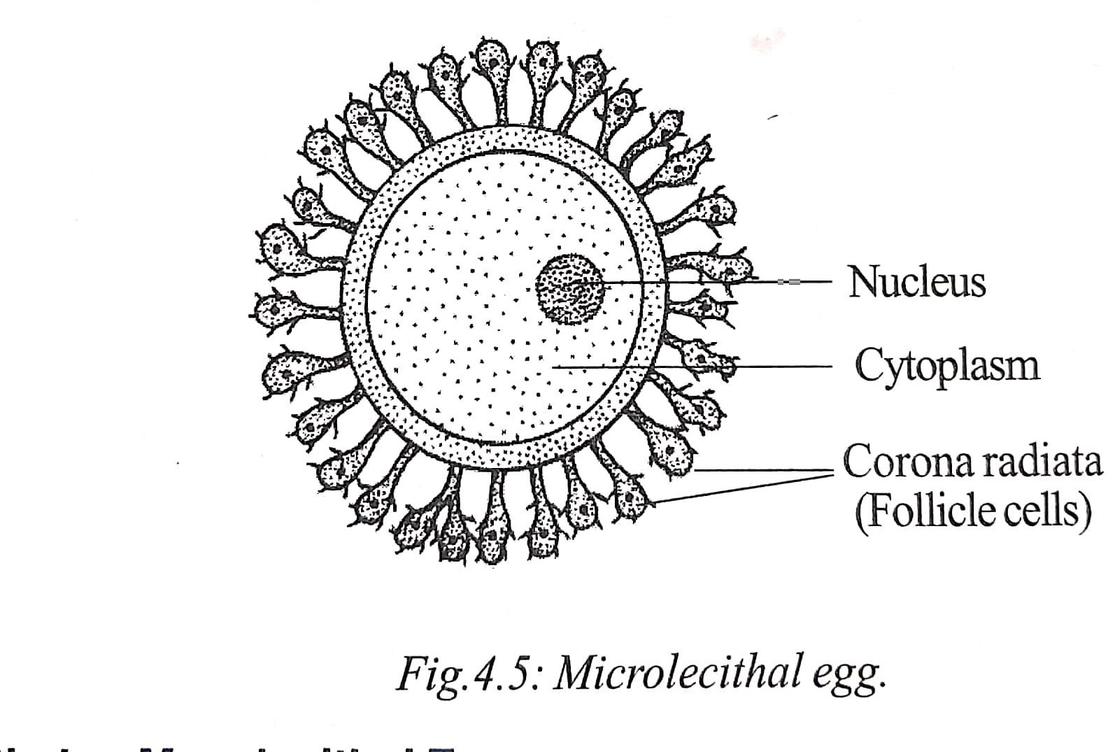

Slide 18
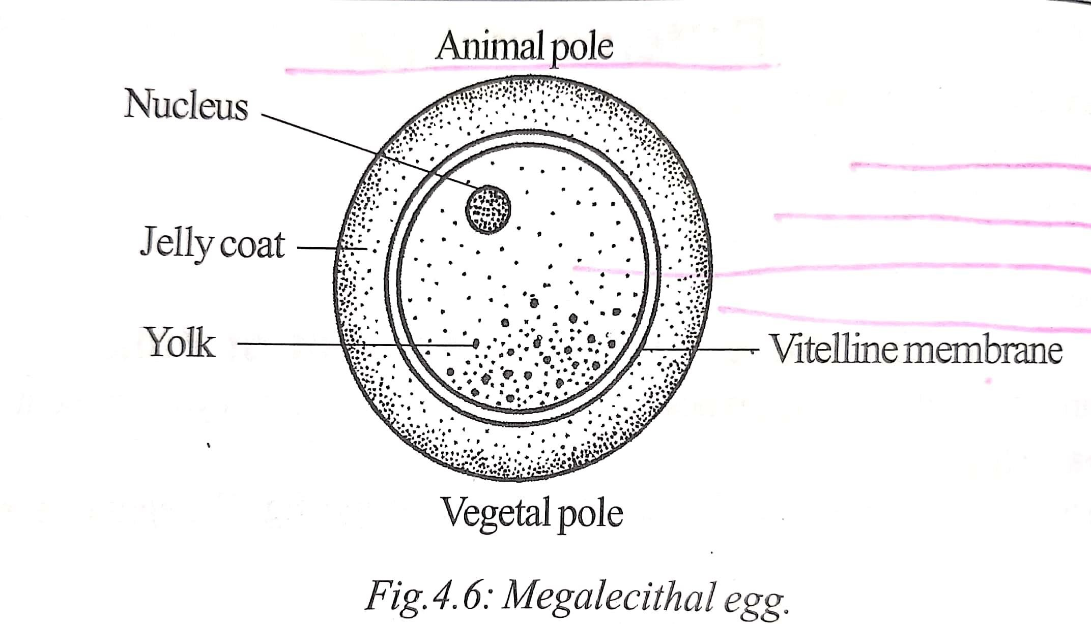

Slide 19
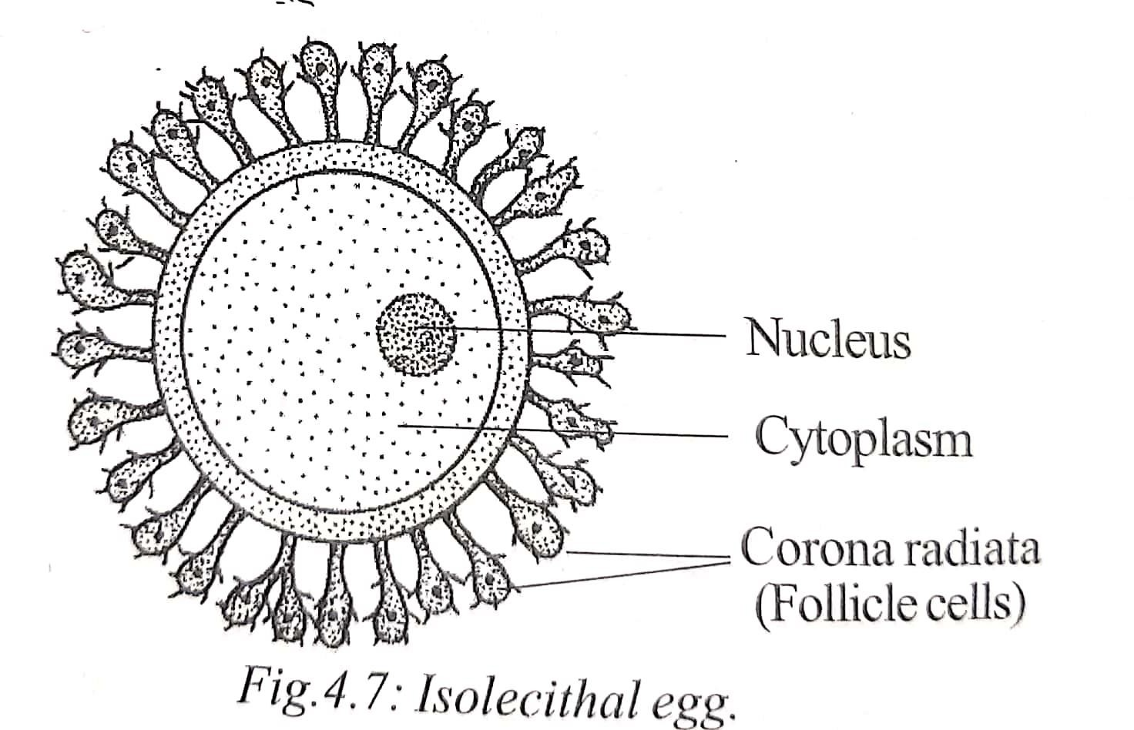

Slide 20
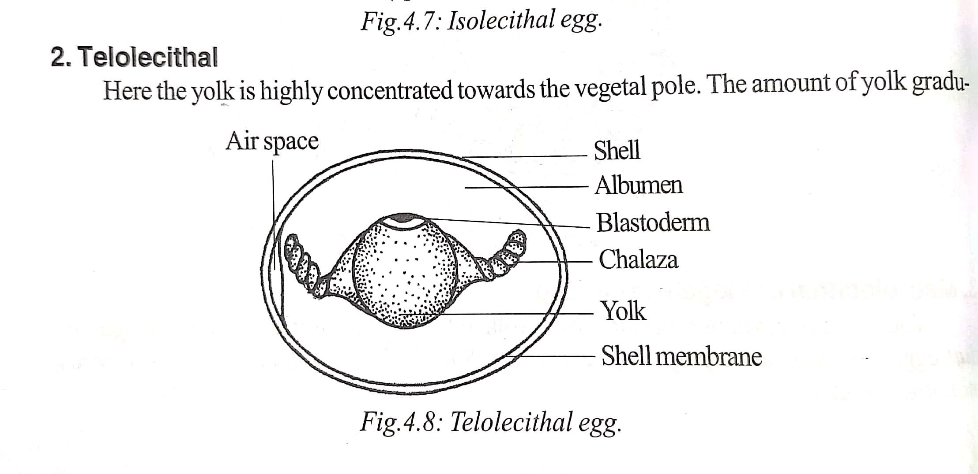

Slide 21
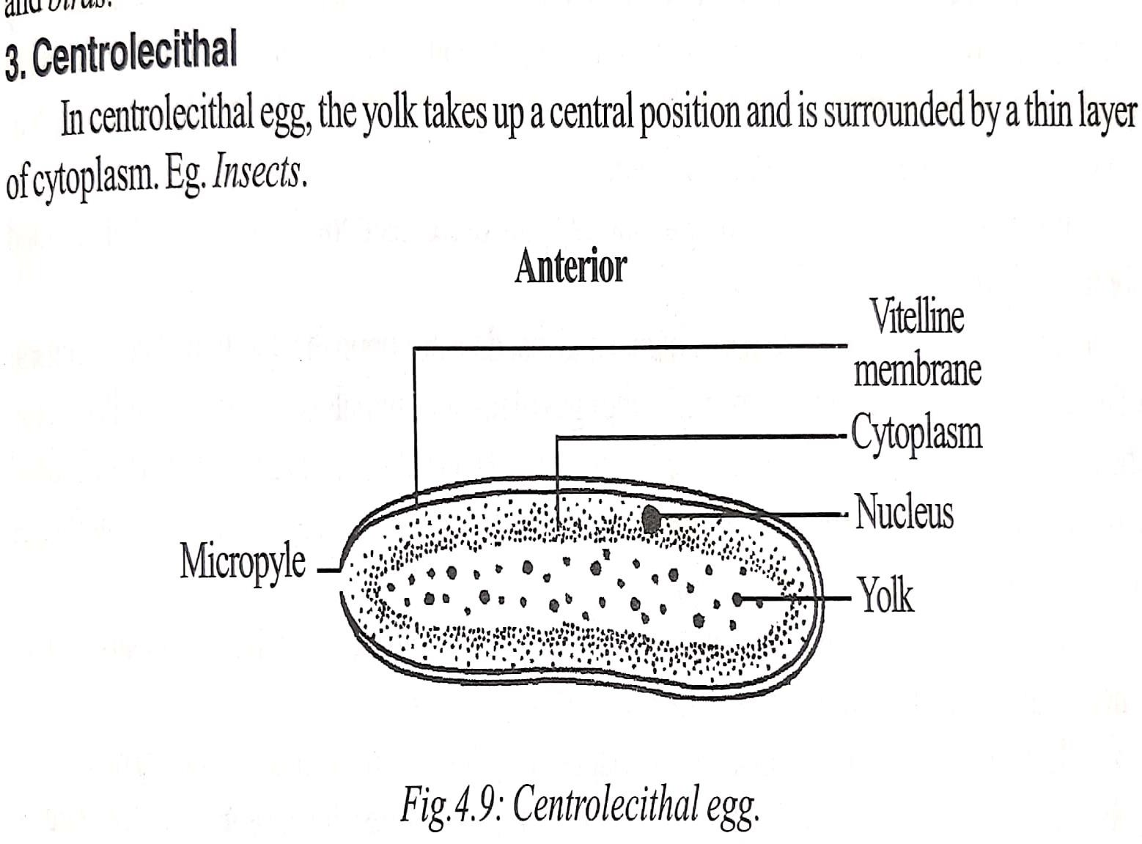

Slide 22
THE END

